Slide 1
W&M KP Dispense Inaccuracies Analysis Report
Analysis by:
Henry Kimeu

Slide 2
Introduction.
Potential Root Causes.
Analysis.
Next Steps.

Slide 3
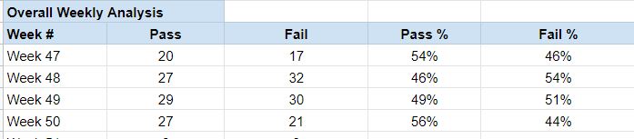
Introduction
This report represents analysis results to determine root-cause for increasing numbers of dispense inaccuracies during W&M KP Sealing exercise.
So far, the Pass and Failure rates are as shown below;

Slide 4
Potential Root-Causes (RC)
This report investigates the following potential root causes.
RC 1: Technician.
Whether there is a relationship between technicians from the number of calibrated KPs which later Passed or Failed verification.
RC 2: Calibration date
To check for patterns between calibration dates and subsequent Fail or Pass rates.
RC 3: Tank level and flow rates.
To establish the relationship between tank levels, flow rates and dispense errors.
RC 4: 5V flowmeter power supply
To establish whether the 5V supply to the KP flowmeter has an effect on dispense accuracy
RC 5: Canister Used
To check for trends between canisters used and dispense errors.

Slide 5
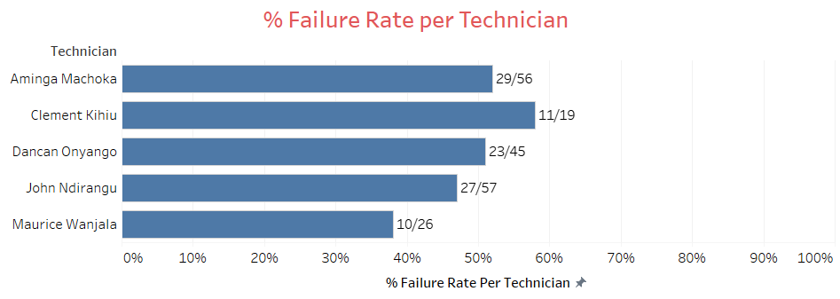
RC 1: Technician
*Failure rate represents proportion of the total each Technician calibrated during hardware upgrade.
The failure rates are between 38% and 57% among all Technicians.
This does not point to a Technician-caused error during calibration (done during Hardware Upgrade).

Slide 6
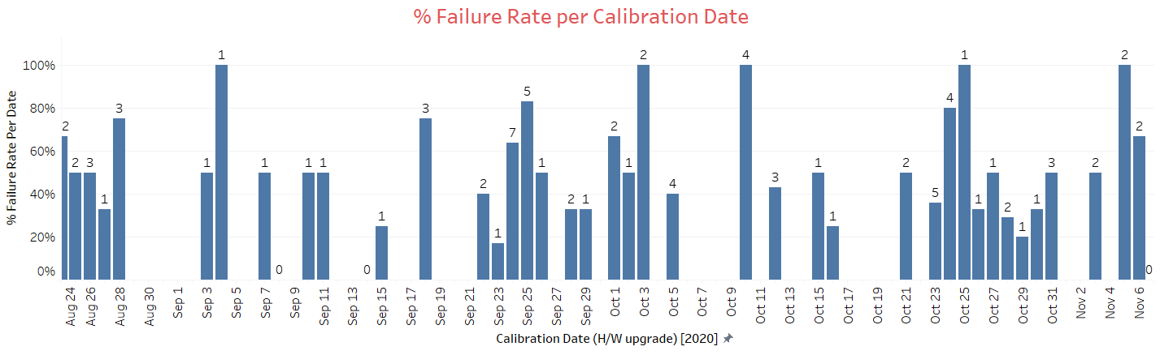
RC 2: Calibration Date
There is no identifiable pattern which can point to a direct relationship between failure rates and calibration dates

Slide 7
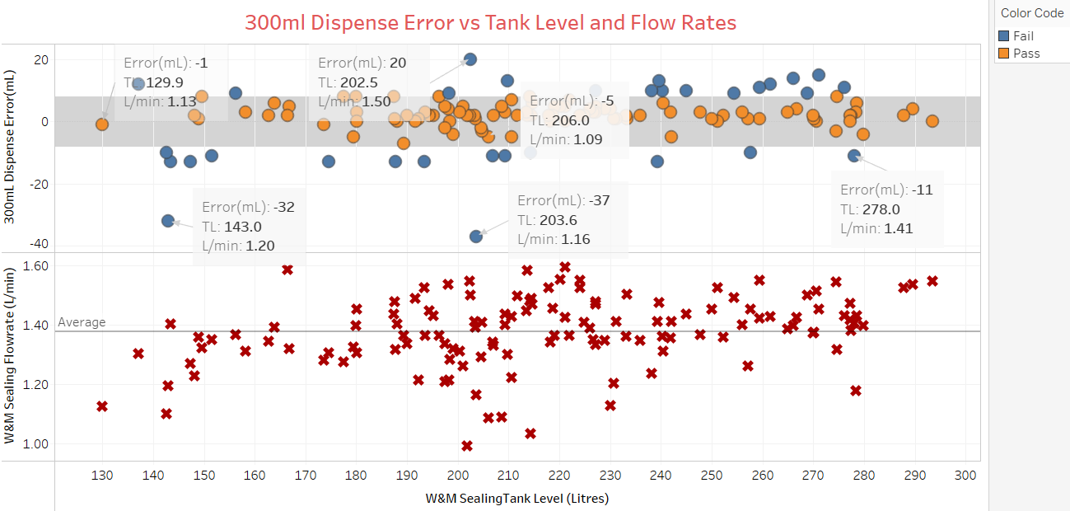
RC 3: Tank Level & Flow Rates
Grey area shows allowable error range.
There is no identifiable pattern to link tank level, flow rate and dispense error

Slide 8
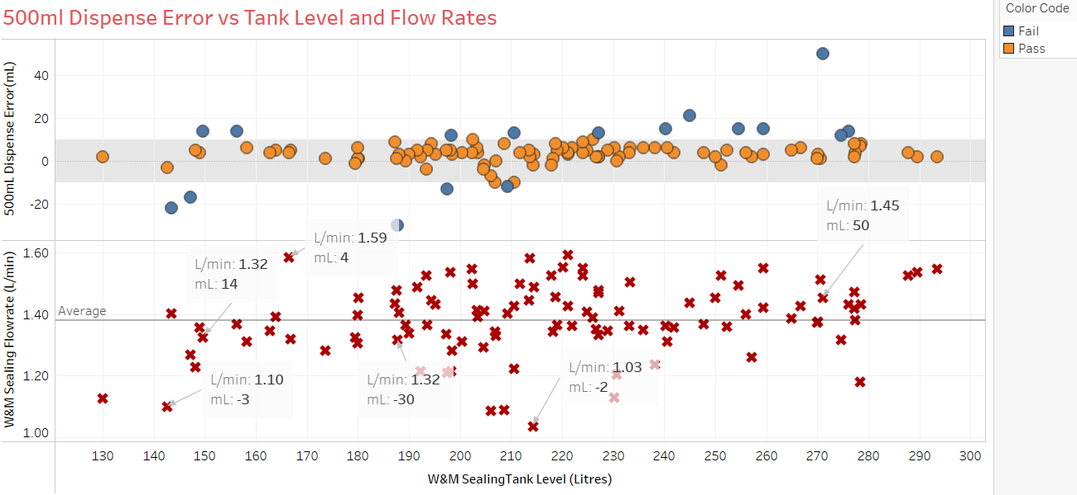
RC 3: Tank Level & Flow Rates
Grey area shows allowable error range.
There is no identifiable pattern to link tank level, flow rate and dispense error

Slide 9
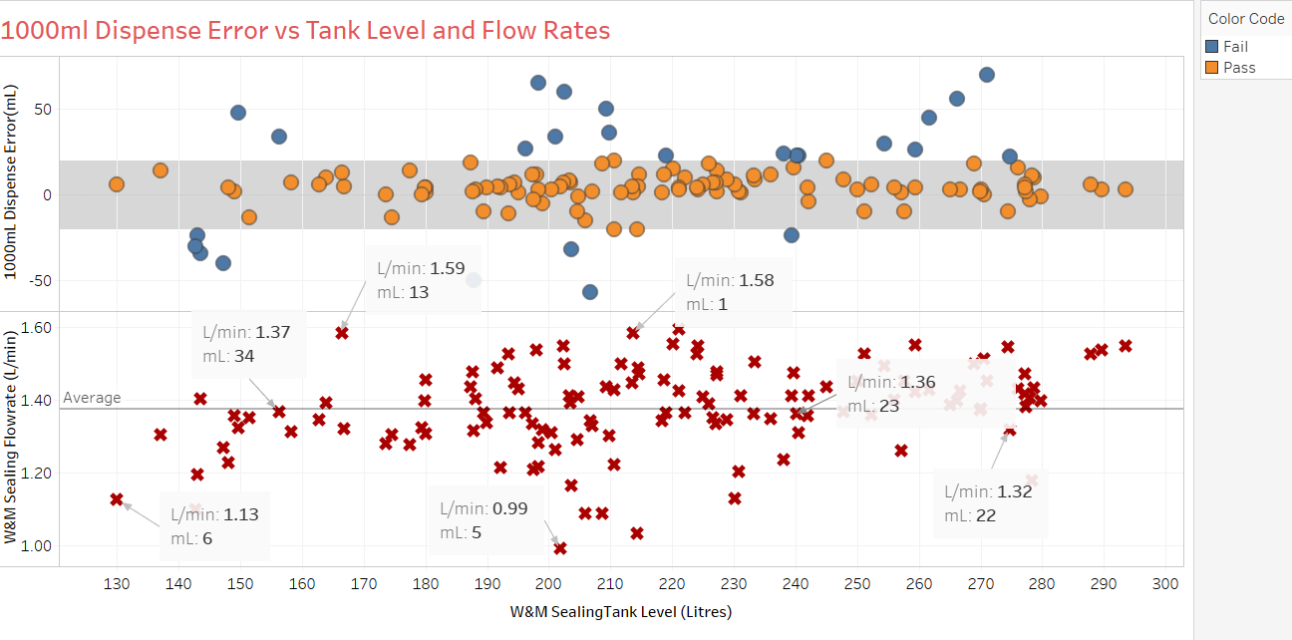
RC 3: Tank Level & Flow Rates
Grey area shows allowable error range.
There is no identifiable pattern to link tank level, flow rate and dispense error

Slide 10
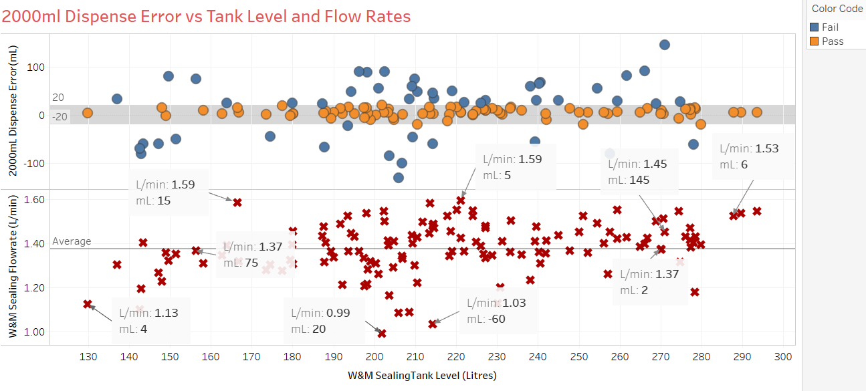
RC 3: Tank Level & Flow Rates
Grey area shows allowable error range.
There is no identifiable pattern to link tank level, flow rate and dispense error

Slide 11
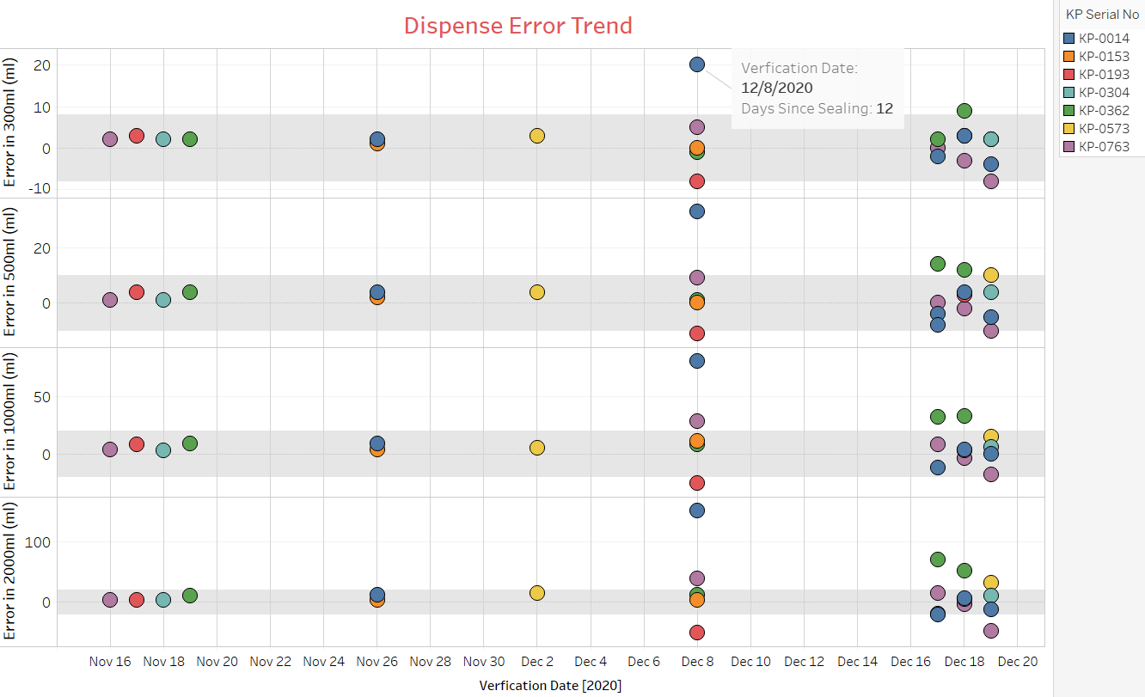
RC 4: 5V Flowmeter Power Supply
7 recently sealed KPs were selected for periodic accuracy verification.
*Grey area shows allowable error range.
5 out of the 7 KPs have failed accuracy verification since when they were sealed by W&M.
The earliest failure was recorded 12 days after W&M sealing.
NB: W&M :- Weights and Measures

Slide 12
Next Steps
4 KPs from the 5 that failed among the 7KPs selected for periodic verification will be upgraded to the 12V FLM BL PCB.
This will establish the improvement that 12V flowmeter power supply has on a KP’s dispense accuracy.
These 4 KPs will add on to the 16KPs that have a 12V BL PCB whose accuracy is being verified after 2 days for the last 1 month. Verification will be carried out until we are ready to roll out the 12V BL PCBs to the entire network.
Link to test report 12V BL PCB Test Report

